Slide 1

Federal University of Sergipe Departament of Information Systems
Russia 2018 World Cup Route Using The Uniform Cost Method
Clovis Oliveira, Fabricia Santos, Paulo Victor e Weslley Henrique

Slide 2
SUMMARY
MOTIVATION
SOLUTION
MAIN CODE
CONCLUSION

Slide 3


Slide 4

MAP RUSSIA

Slide 5
Russia 2018 World Cup Route Using The Uniform Cost Method

Slide 6
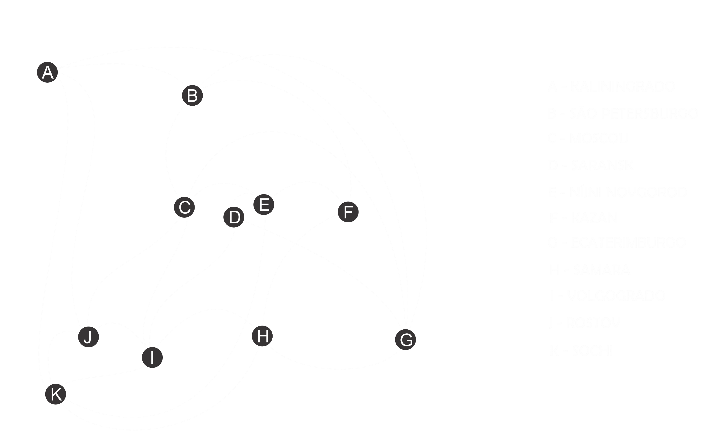

Slide 7
G(X) = X-MIN / MAX-MIN

Slide 8
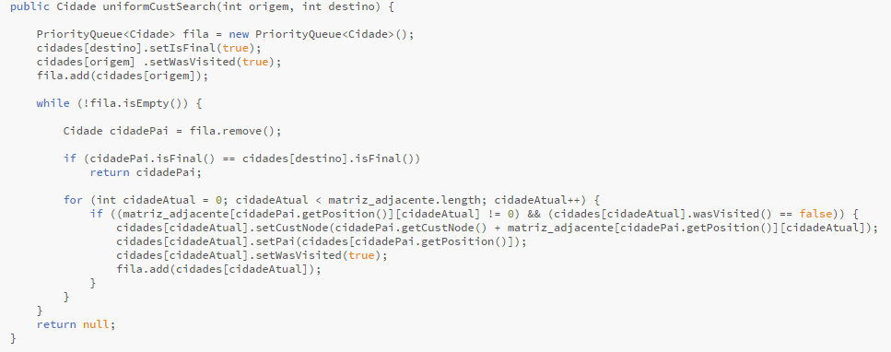

Slide 9
APLICATION

